Slide 1
Data Analysis
Project by: Deon Fernandes, Aarya Mahajan, Dhrumi Shah

Slide 2
Agenda
Abstract
Introduction
Problem Statement + Primary goals
Proposed System Architecture
Modules
System Requirement
Results
Summary
References

Slide 3
Abstract
Analytics is all about solving problems and Data analytics is the soul of the internet of things (IoT) technology.
Analytics is everywhere, this could be working in a variety of different industries such as aviation, industries or government.
With so many organizations looking to capitalize on data to improve their processes, it's a hugely exciting time to start a career in analytics
Notes:
while it may be a few years before we see data analytics as a common school subject, there's no denying how critical the discipline is likely to become in the very near future.

Slide 4
What is Data Analysis?
Data analysis is a process of inspecting, cleansing, transforming, and modelling data with the goal of discovering useful information, informing conclusions, and supporting decision-making.
Data analysis has multiple facets and approaches, encompassing diverse techniques under a variety of names, and is used in different business, science, and social science domains.
In today's business world, data analysis plays a role in making decisions more scientific and helping businesses operate more effectively.

Slide 5
Data Analysis on Netflix
Netflix is one of the largest providers of online streaming services. It collects a huge amount of data because it has a very large subscriber base.
Netflix like many others is a trending platform with many users, with variety of data which makes the analysis more interesting.

Slide 6
Problem Statement + Primary goals

Slide 7
Some of the most important tasks that we can analyze from Netflix data are:
Understand what content is available
Understand the similarities between the content
What exactly Netflix is focusing on
Do the Sentiment Analysis

Slide 8
Architecture
Fetching Netflix Title Dataset
Importing Libraries into Python
Creating Data graphs, Charts
Presentation
Conclusion
Creation of GUI

Slide 9
Modules
Numpy : Used for making Linear Algebraic Calculation
Pandas: Used to read and prepare Data
Plotly: Used for Data Visualization
TextBlob: For Sentiment Analysis
Tkinter: For GUI
PIL(Pillow): Image Processing
Netflix Data set: To read the available Data

Slide 10
System Requirements
Intel i3 or higher
Windows 7,8,10 or 11 which can run Python 3.10
System with Internet Connection

Slide 11
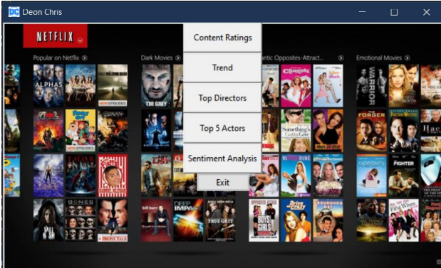
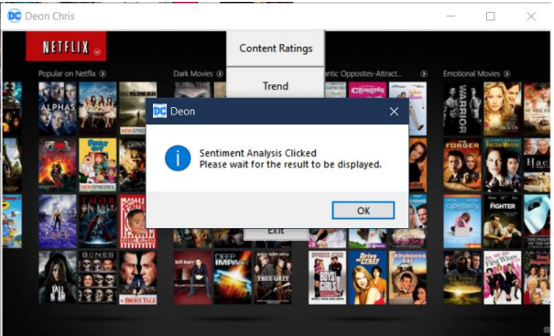
Results

Slide 12
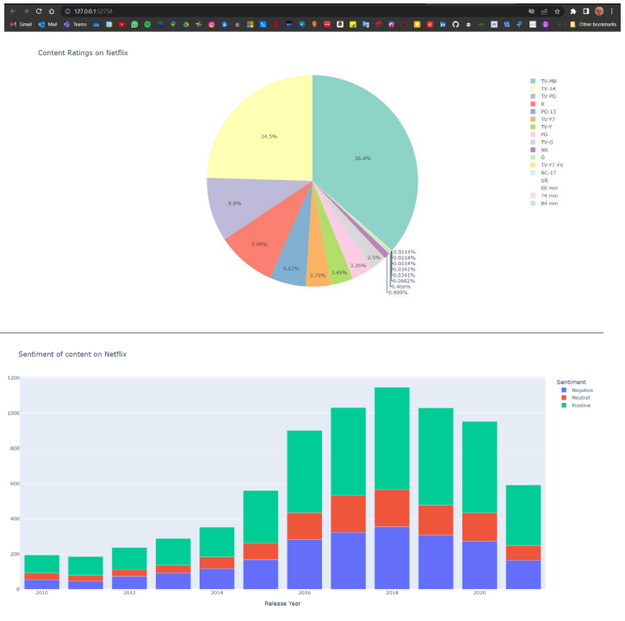
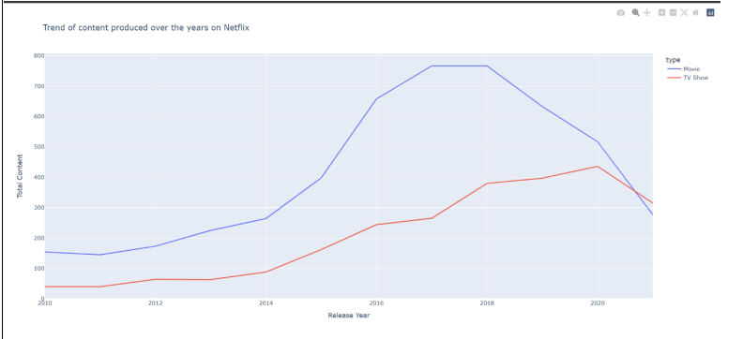

Slide 13
Summary
By this we can understand type of content is available on Netflix, the similarities between the content and what the ultimate of goal of Netflix is and could be planning.

Slide 14
References
https://www.netflix.com/browse
https://en.wikipedia.org/wiki/Data_analysis
https://thecleverprogrammer.com/2021/01/16/netflix-data-analysis-with-python/
https://data.world/chasewillden/netflix-shows

Slide 15
Where there is data smoke there is Business Fire🔥
“
”
Thomas Redman

Slide 16
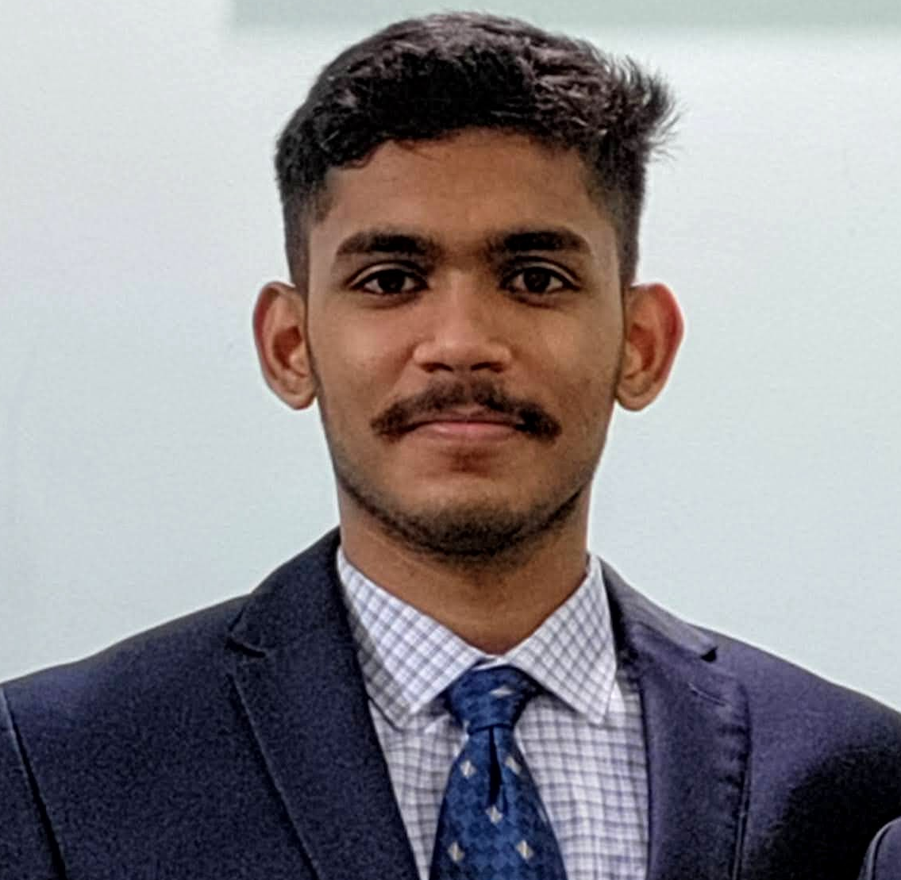


Meet our team
Deon Fernandes
Aarya Mahajan
Dhrumi Shah

Slide 17
Thank you

